Slide 1
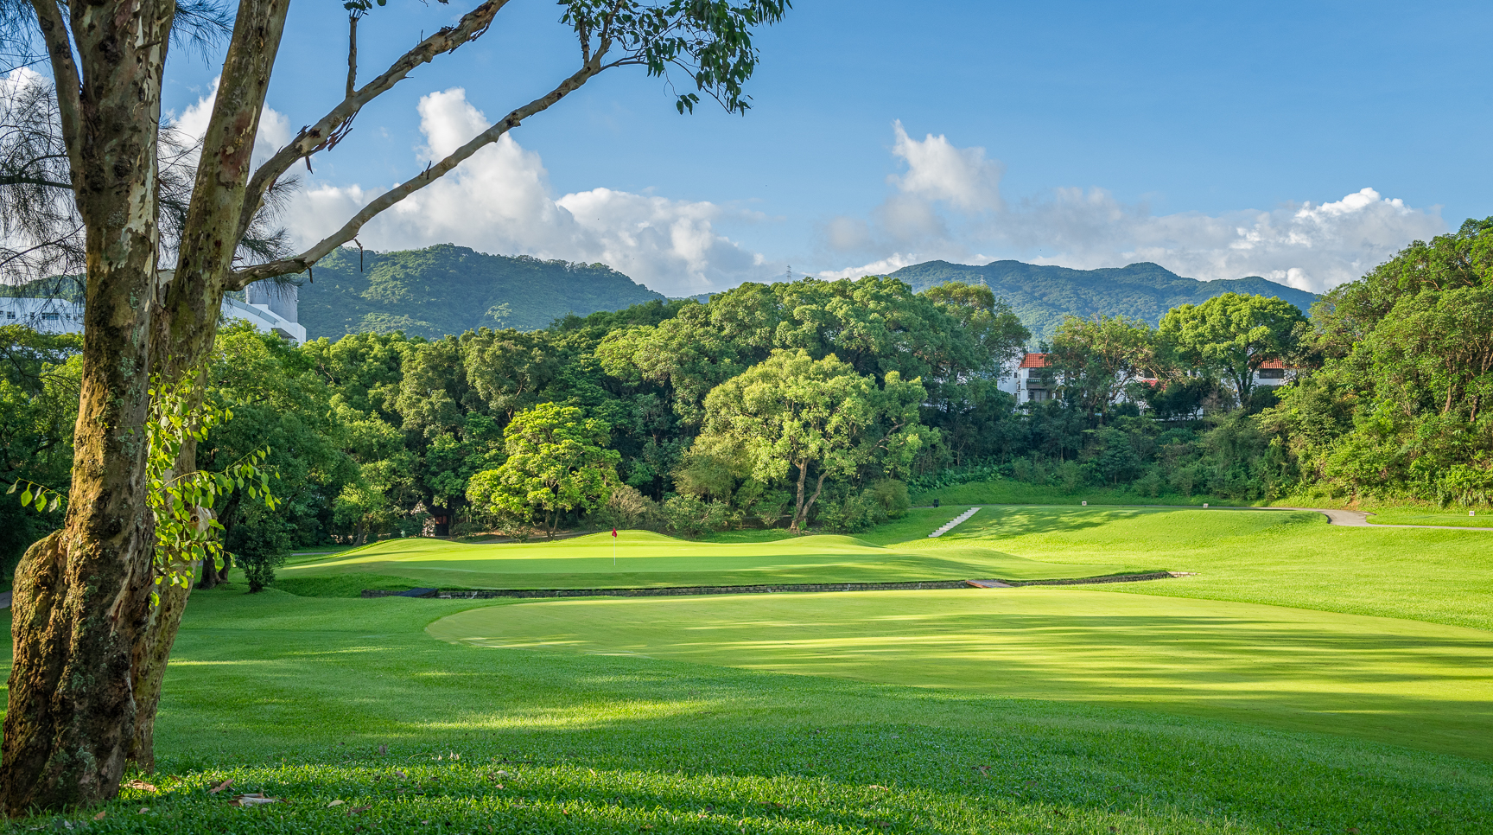

LANDSCAPE & TREES
Old Course Hole #1
O.N.E. living heritage

Slide 2
Response to CEDD “responses” on 14th and 19th June regarding Incompetent Landscape Impact Assessment
O.N.E. living heritage

Slide 3
NOTHING PRESENTED BY CEDD ON 14th & 19TH JUNE DETRACTS FROM HKGC ‘LANDSCAPE & TREES’ PRESENTATION ON 14TH JUNE
On 14th June, a TPB Member asked CEDD why there is no supporting evidence for tree retention provided and the verbal response provided by CEDD’s consultant was firstly that the site is not hilly, and secondly there is no requirement to provide such evidence.
Both statements are incorrect and misleading.
O.N.E. living heritage

Slide 4

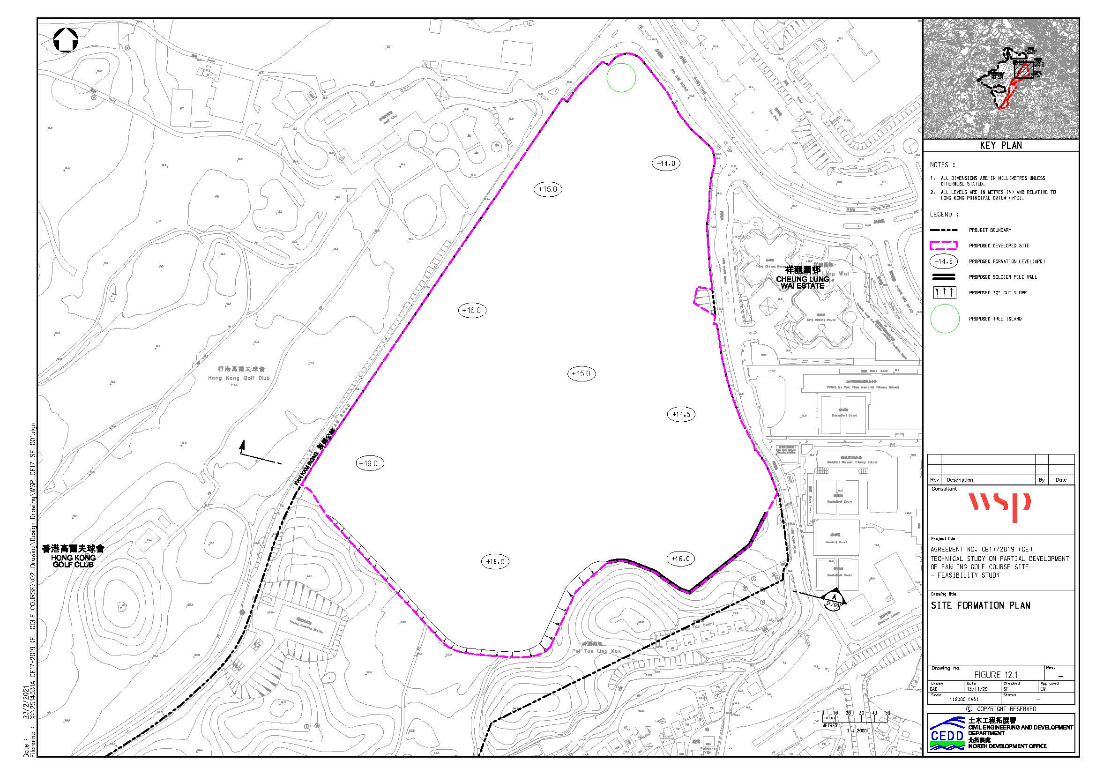
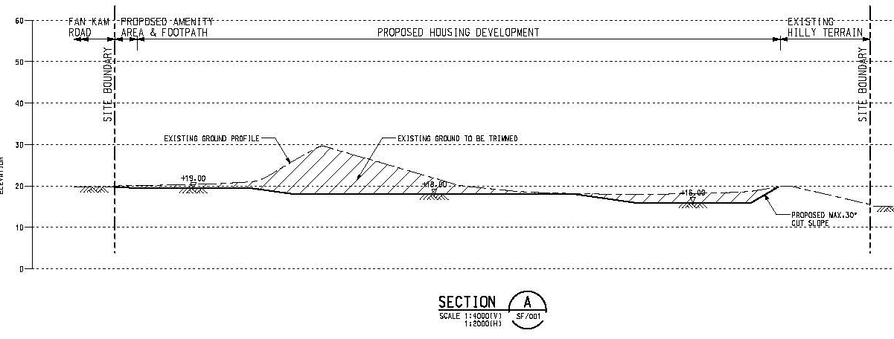
Response to CEDD information presented on 19th June
No Supporting Evidence for Tree Preservation
CEDD’s Site Formation Plan (left) and Section (below) shows clear intent to flatten the highly undulating site to create the housing platforms.
The supposedly preserved tree cluster of ~100 trees is located on the small hill they intend to remove according to the site formation plan & section.
One “Tree Island” to preserve the one tree of “High Amenity value”
O.N.E. living heritage

Slide 5
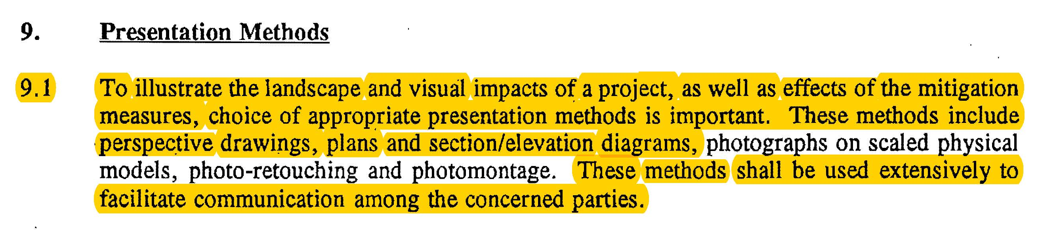
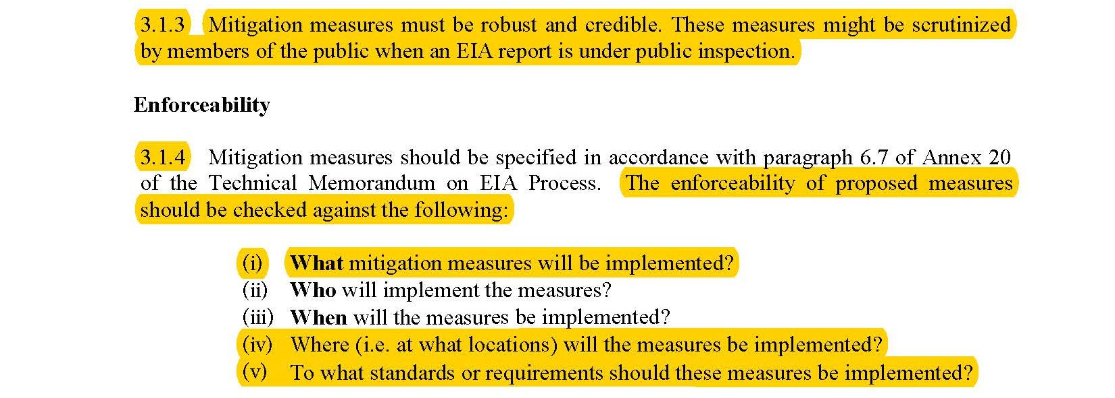
Response to CEDD information presented on 19th June
No Supporting Evidence for Tree Preservation
EIAO TM Annex 18, cl.9.1
Contrary to statement by CEDD on 14th June, it is a firm requirement of the EIAO TM and Guidance Notes that supporting evidence such as “…plans, section/elevation diagrams…shall be used extensively to facilitate communication…” to demonstrate that mitigation measures are ‘robust and credible’. They must be ‘practical and viable to implement rather than design intent’. ‘Assessment should always be supported by…clear evidence’.
EIAO Guidance Note 3, cl.3.1.3 & 3.1.4
O.N.E. living heritage

Slide 6
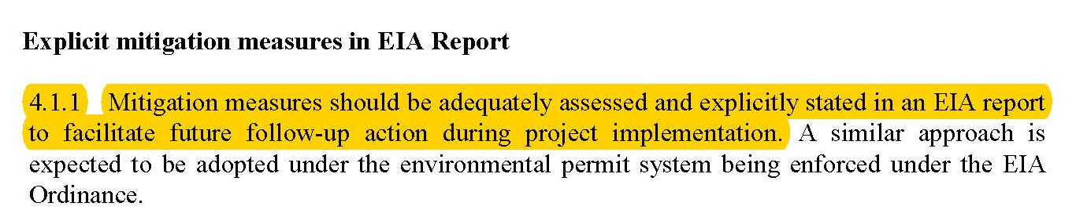
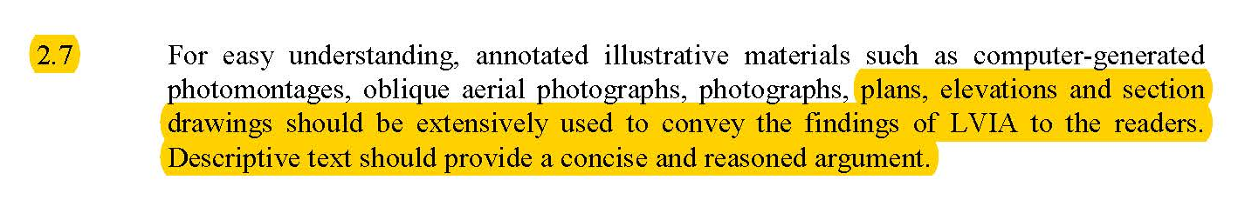
Response to CEDD information presented on 19th June
No Supporting Evidence for Tree Preservation
EIAO Guidance Note 3/2010, cl.4.1.1
Contrary to statement by CEDD on 14th June, it is a firm requirement of the EIAO TM and Guidance Notes that supporting evidence such as “…plans, section/elevation diagrams…shall be used extensively to facilitate communication…” to demonstrate that mitigation measures are ‘robust and credible’. They must be ‘practical and viable to implement rather than design intent’. ‘Assessment should always be supported by…clear evidence’.
EIAO Guidance Note 8/2010, cl.2.7
O.N.E. living heritage

Slide 7
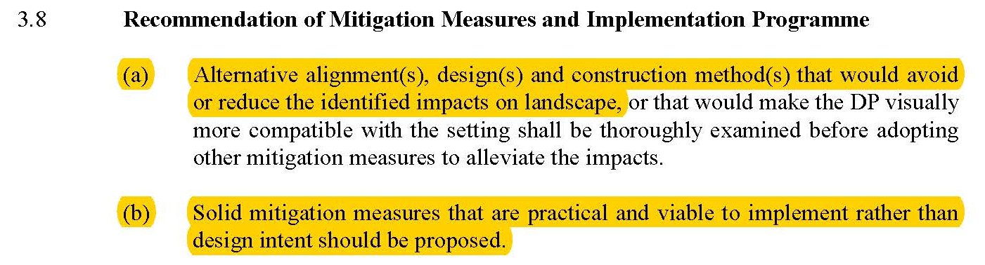
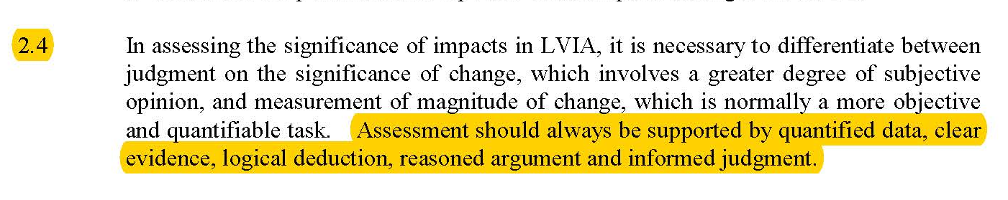
Response to CEDD information presented on 19th June
No Supporting Evidence for Tree Preservation
EIAO Guidance Note 8/2010, cl.3.8(a) and (b)
Contrary to statement by CEDD on 14th June, it is a firm requirement of the EIAO TM and Guidance Notes that supporting evidence such as “…plans, section/elevation diagrams…shall be used extensively to facilitate communication…” to demonstrate that mitigation measures are ‘robust and credible’. They must be ‘practical and viable to implement rather than design intent’. ‘Assessment should always be supported by…clear evidence’.
EIAO Guidance Note 8/2010, cl.2.4
O.N.E. living heritage

Slide 8
NOTHING PRESENTED BY CEDD ON 14th & 19TH JUNE DETRACTS FROM HKGC ‘LANDSCAPE & TREES’ PRESENTATION ON 14TH JUNE
On 14th June, CEDD showed a photograph of grass growing under the shade of a large tree on one side of a golf hole at Fanling and claimed this is evidence that HKGC are overstating the adverse impacts of shading by tall buildings on golf turf.
This simply demonstrates CEDD’s, and their Consultant’s, lack of knowledge of golf turf agronomy and emphasizes that their assessments are based on false information and poor understanding.
O.N.E. living heritage

Slide 9
Severe Shading Impacts caused by development
Severe Shading Impacts on Fanling Golf Course West of Fan Kam Road
Grass grows happily under the trees that line the sides of the golf holes at FGC for 2 main reasons:
  The grass in the ‘rough’ areas under the trees is a different grass species from the grass on the greens, tees and fairways.
  The grass under the trees in the rough is allowed to grow taller than the grass in the greens, tees and fairways and is therefore under much less stress.
Golf course turfgrass species on greens, tees and fairways are cut to a short height so as to create the correct ‘playability’ of the golf turf. This puts a lot of stress on the grass which therefore requires a lot of direct sunlight to support its healthy growth.
The grass on the greens is cut very short (shorter than the tees and fairways) to create a fast putting surface. The grass on the greens, and also the practice putting green, are therefore under the most stress and require the most direct sunlight for healthy growth.
This explains why CEDD’s photograph of the grass growing happily under tree shade is not relevant and betrays their lack of adequate technical knowledge of turfgrass agronomy.
The proposed PHD will cause serious adverse impact to the golf turfgrass on the west side of Fan Kam Road as the very high tower blocks will directly shade the 18th hole of the Old Course, portions of several holes on the New and Eden courses that are used for the Hong Kong Open (HKO), and also the practice putting green that is critical during all competitions, local and international.
Landscape & Trees
O.N.E. living heritage

Slide 10
NOTHING PRESENTED BY CEDD ON 14th & 19TH JUNE DETRACTS FROM HKGC ‘LANDSCAPE & TREES’ PRESENTATION ON 14TH JUNE
Responses provided by CEDD on 19th June to try to explain away the inadequacies and inaccuracies of their incompetent Tree Survey are further demonstrations of obfuscation and misleading statements.
O.N.E. living heritage

Slide 11
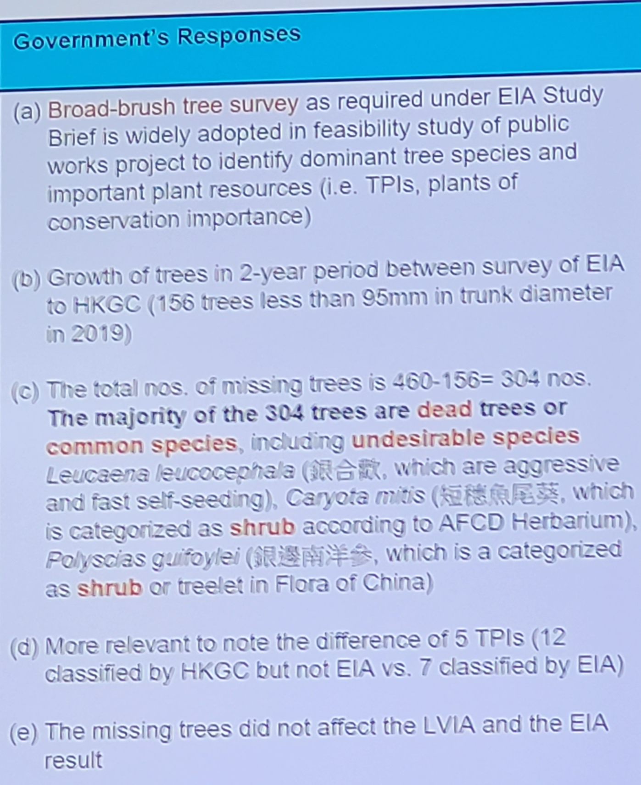
Response to CEDD information presented on 19th June
Incompetent Individual Tree Survey – Tree Numbers
CEDD responses to criticism of the inaccurate survey of tree numbers should not be acceptable to Government or the taxpayer, since taxpayer money pays for a survey that does not satisfy the Technical Circular:
Response (a): The Tree Survey of Sub Area 1 is an “Individual Tree Survey” which is entirely different from the Broad-Brush Survey that was undertaken in Sub Areas 2, 3 & 4. The Individual Tree Survey, by definition, should have identified every individual tree. To claim otherwise is to defy logic and common sense.
Response (b): Yes, this is the HKGC’s tree survey audit estimate.
Response (c): This is obfuscation and very misleading. Of the 304 missing trees only 11 are dead and 16 are Leucaena. Hardly the stated ‘majority’. Also, it matters not how many of the remaining 277 missing trees are common spp - they should all be surveyed. Many common species are beautiful with excellent ecological value.
Response (d): It is agreed the EIAs failure to identify 9 of the 33 large TPIs is critical – that is one of our criticisms.
Response (e): This statement is completely wrong. The missing trees obviously affected the proposed number of compensatory trees, which should be ~1500 instead of 996 on a 1:1 basis for felled trees. Furthermore, such a huge difference in tree felling should affect the impact significance in any properly conducted assessment.
The findings of the EIA cannot be trusted.
O.N.E. living heritage

Slide 12
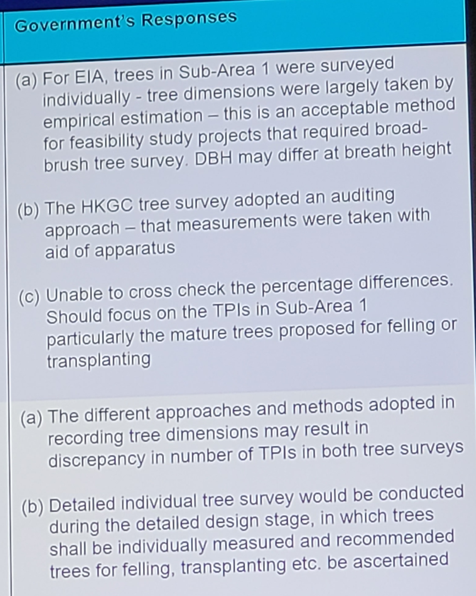
Response to CEDD information presented on 19th June
Incompetent Individual Tree Survey – Tree Dimensions and TPIs
CEDD responses to criticism of the consultant’s grossly inaccurate tree survey dimensions and identification of TPIs should not be acceptable to Government or the taxpayer, since taxpayer money pays for a survey that does not satisfy the Technical Circular and Practice Note:
Responses (a) & (b): The surveyors admit they didn’t measure the trees using ‘apparatus’ (e.g., tape measures for DBH) but guessed the dimensions. This is an unacceptable excuse. Tree Survey of Sub-Area 1 is called Individual Tree Survey (different from Broad-Brush Survey undertaken in Sub Areas 2 to 4) and is presented in a detailed tree schedule as if all information therein is accurate and precise as per DEVB TC 4/2020 “Tree Preservation” with Tree DBH described to 5mm, in some cases to 1mm; tree heights to 1m, in some cases to 0.5m, and tree canopy spreads likewise. According to CEDD’s response, it is pretending to be something it is not and consequently highly misleading to the reader and decision-makers.
Second Response (a) The Consultant’s seriously flawed identification of large TPIs is based on these ‘guessed’ dimensions. It is no surprise that they grossly underestimated the numbers of large TPIs (24 large TPIs instead of 33 large TPIs).
Furthermore, the ability to preserve the large TPIs is completely overestimated in the EIA because the trees are far bigger than their ‘guessed’ dimensions.
The findings of the EIA cannot be trusted.
O.N.E. living heritage

Slide 13
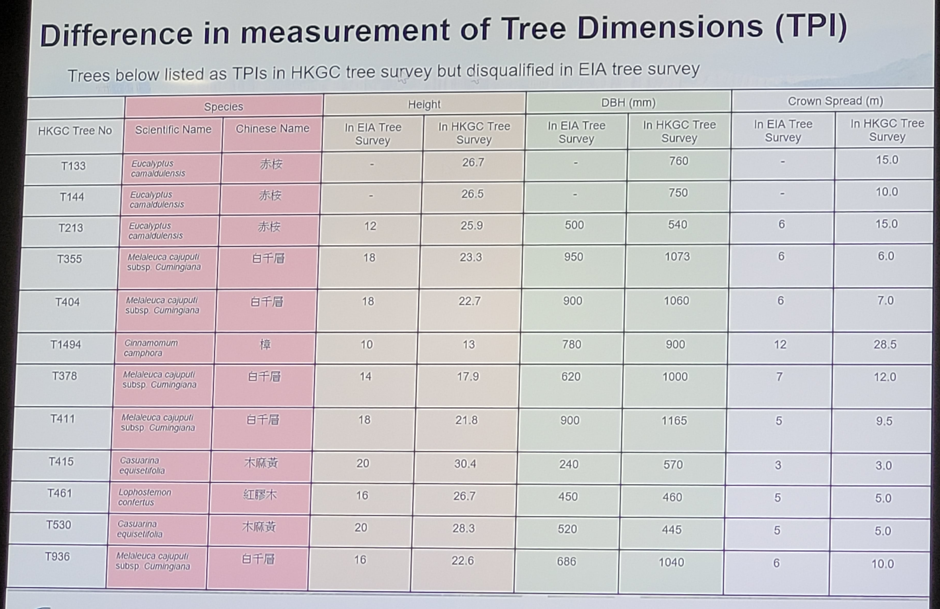
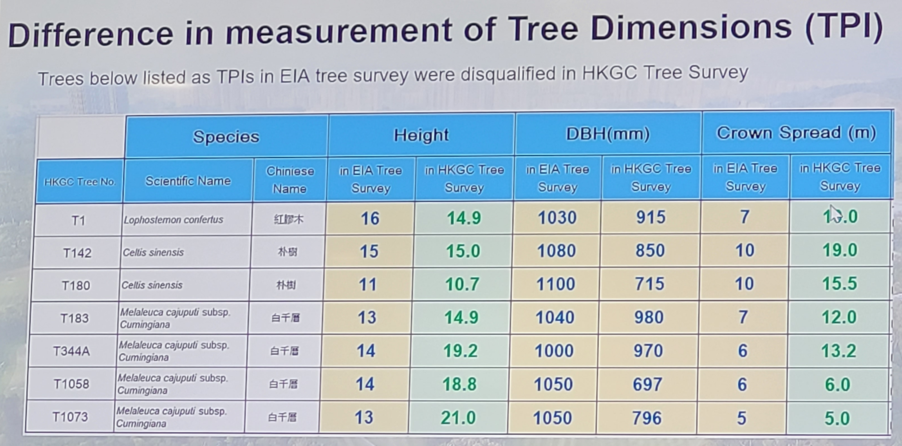
Response to CEDD information presented on 19th June
Incompetent Individual Tree Survey – Tree Dimensions and TPIs
In these two slides CEDD concede that:
(Top Slide) They failed to identify 12 large TPIs on the PHD/ School/ Amenity Strip site because their ‘guessed’ dimensions are much smaller than the true dimensions.
(Bottom Slide) They wrongly identified 7 large TPIs on the PHD/ School/ Amenity Strip site that should NOT be TPIs because their ‘guessed’ dimensions are larger than the true dimensions.
The net increase of 5 large TPIs on the PHD/ School/ Amenity Strip site increases the total from 24 to 29 Large TPIs as reported in HKGC Tree Survey Audit submitted in May 2023.
CEDD seem to think such huge mistakes are acceptable?
Furthermore, since then URBIS Certified Arborists visited the areas in Sub-Area 1, outside the boundary of the PHD/School/Amenity Strip site (and not included in the HKGC Tree Survey Audit submitted in May 2023) and found another 4 large TPIs raising the total to 33 large TPIs in Sub-Area 1.
The findings of the EIA cannot be trusted.
O.N.E. living heritage

Slide 14
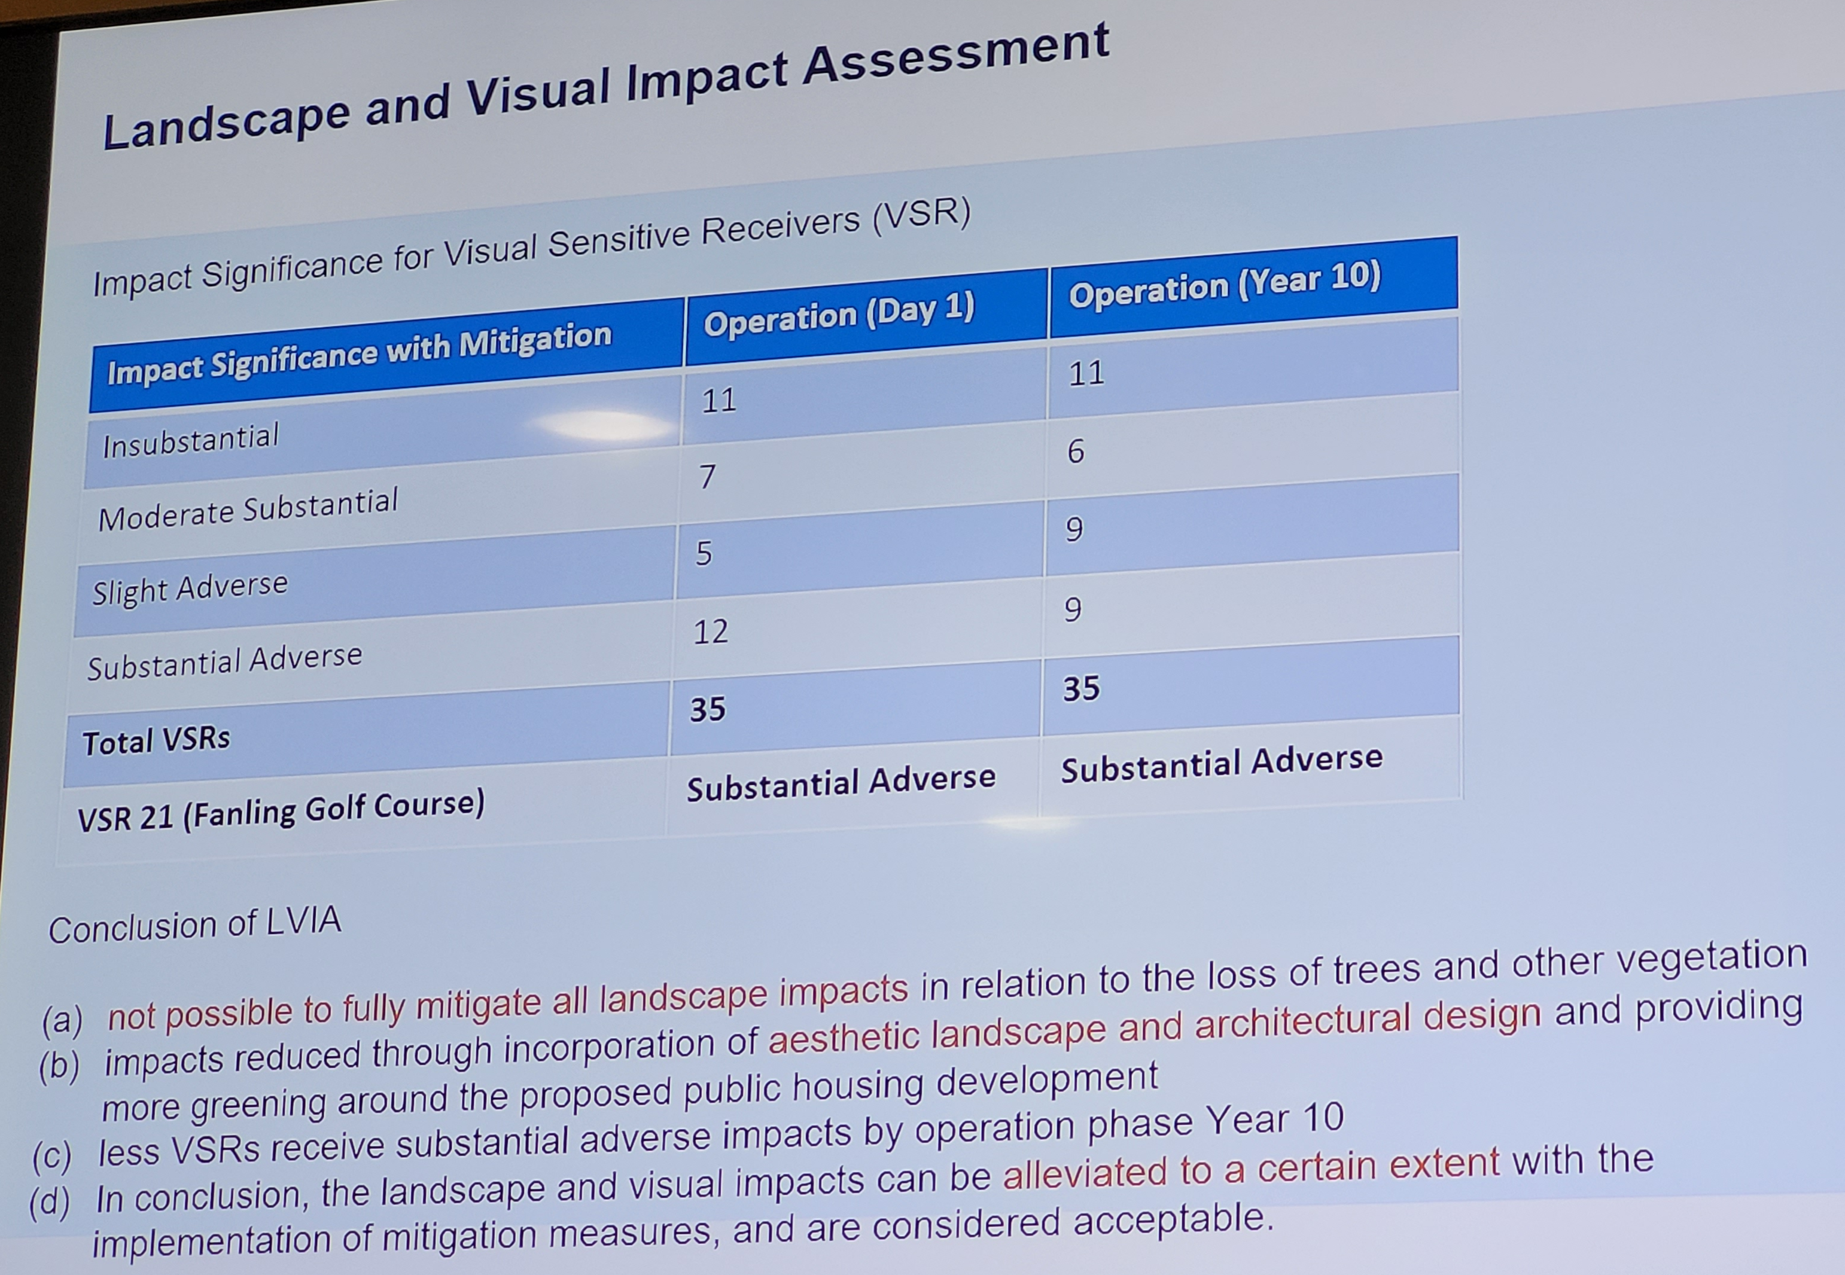
Response to CEDD information presented on 19th June
Failure to Identify Substantial Adverse Significance of Landscape Impacts
In response to HKGC’s criticism that the EIA failed to identify five substantial adverse landscape impacts that render the project unacceptable in accordance with Annex 10 of EIAO TM, CEDD showed a slide of the “Impact Significance for Visually Sensitive Receivers”.
The Visual Impact Assessment and Landscape Impact Assessment are two separate and independent assessments presented in the LVIA Chapter of the EIA.
The slide (including conclusion (a) mentioning ‘loss of trees and other vegetation’) fails abjectly to attempt to describe the actual landscape impacts and does not respond to the criticism.
The findings of the EIA cannot be trusted.
O.N.E. living heritage

