Slide 1
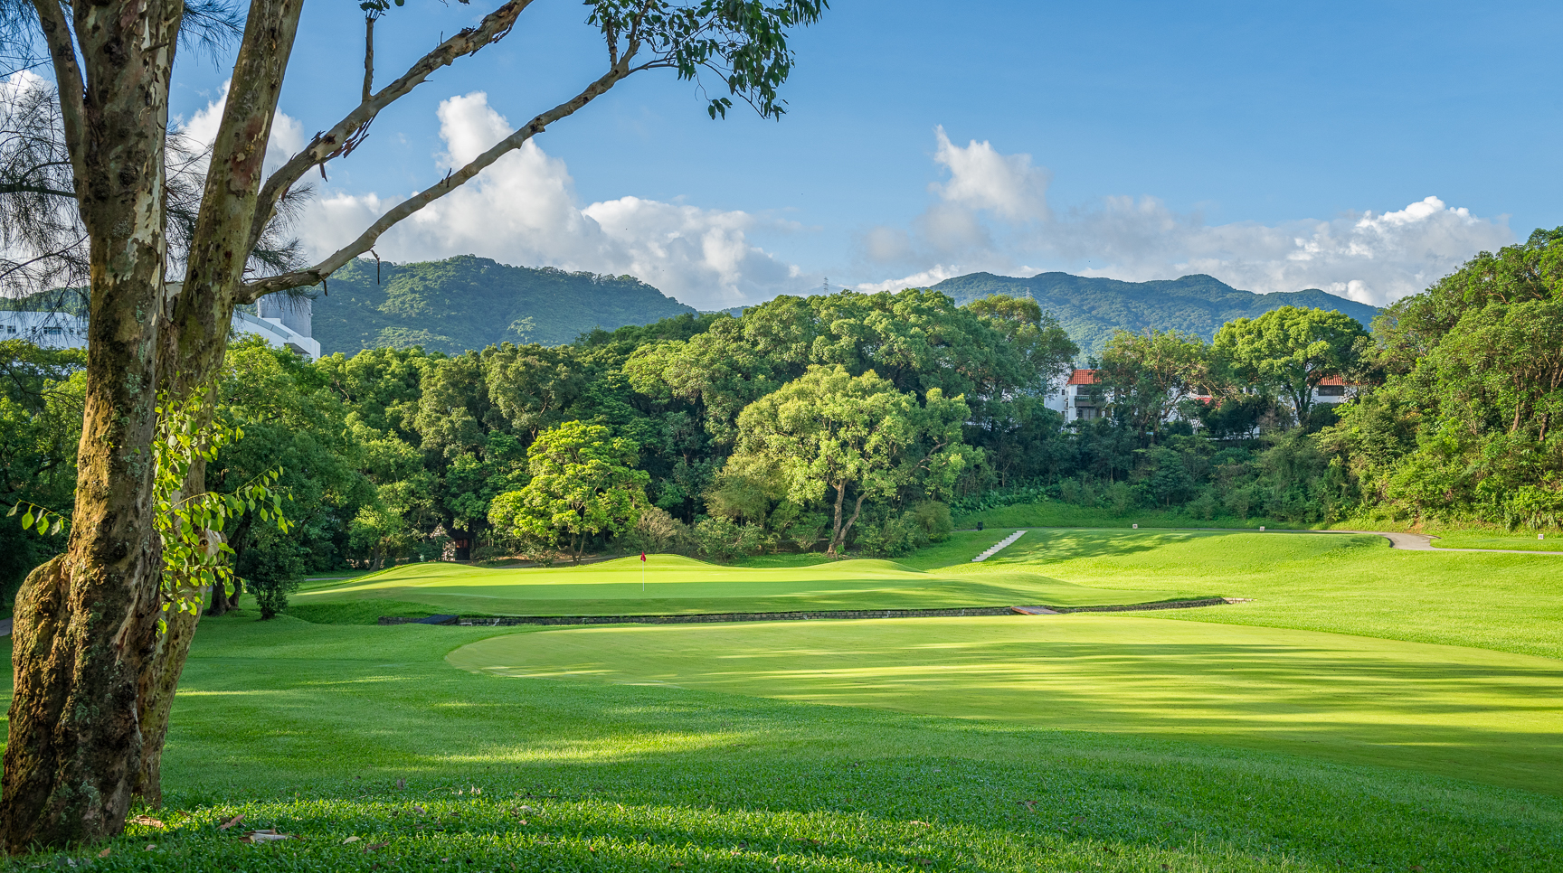
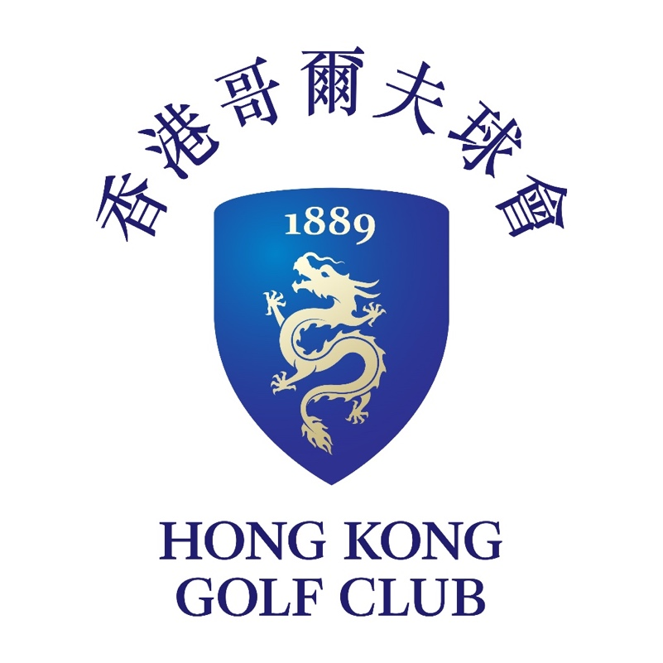
Strategic Importance of FGC to the Northern Metropolis
O.N.E. living heritage

Slide 2
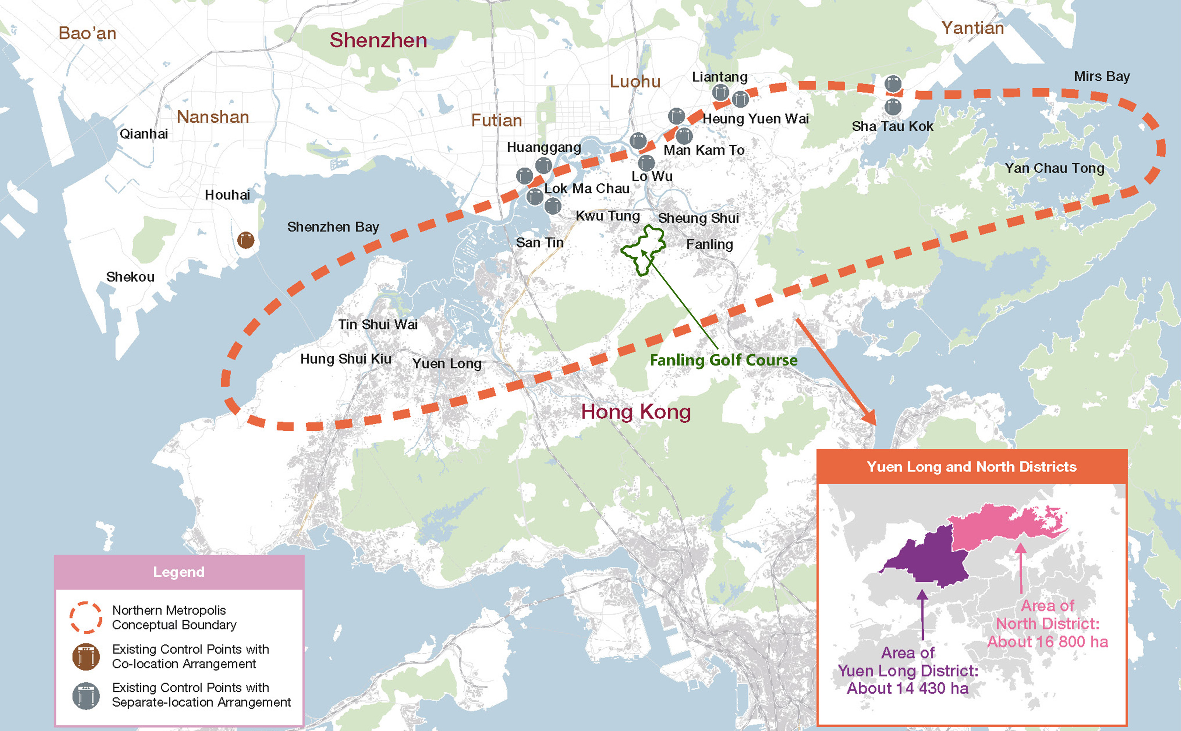
Strategic Importance of FGC to the Northern Metropolis
Northern Metropolis Development Strategy Report (June 2021)
Based on
NMDSR Figure, p.12
O.N.E. living heritage

Slide 3
Strategic Importance of FGC to the Northern Metropolis
Northern Metropolis Development Strategy Report (June 2021)
NMDSR is the single most critical strategic planning document providing context for the draft OZP. [EIA failed to mention or review the NMDSR, which is a breach of requirements of the Study Brief, EIAO TM and Guidance Notes.]
The NMDSR describes:
THREE levels of strategic directions taken by China, the GBA and Hong Kong
SIX planning principles to be adopted under the Development Strategy
A Strategic Spatial Framework of “Twin Cities, Three Circles”
TEN Key Action Directions
Preservation of FGC is in total harmony with the NMDSR policy objectives. Destroying the Old Course would work directly against them.
O.N.E. living heritage

Slide 4
Strategic Importance of FGC to the Northern Metropolis
THREE STRATEGIC DIRECTIONS
“National Level: Our country proposes the development goals of “Construction of Ecological Civilisation” and “Construction of Beautiful Villages”, which places emphasis on the harmonious advancement of economic development and ecological conservation and the balanced development of urban and rural areas……………………”
“GBA Level: The Outline Development Plan puts forward six basic principles, ………. “to pursue green development and ecological conservation……..”
“Hong Kong Level: Hong Kong 2030+ proposes three building blocks as the guiding principles for the territory’s strategic planning, namely ‘planning for a liveable high-density city’, ‘embracing new economic challenges and opportunities’ and ‘creating capacity for sustainable growth’. In addition, the Government proposes development goals of biodiversity and carbon neutrality.”
O.N.E. living heritage

Slide 5
Strategic Importance of FGC to the Northern Metropolis
THREE STRATEGIC DIRECTIONS
“National Level: Our country proposes the development goals of “Construction of Ecological Civilisation” and “Construction of Beautiful Villages”, which places emphasis on the harmonious advancement of economic development and ecological conservation and the balanced development of urban and rural areas……………………”
“GBA Level: The Outline Development Plan puts forward six basic principles, ………. “to pursue green development and ecological conservation……..”
“Hong Kong Level: Hong Kong 2030+ proposes three building blocks as the guiding principles for the territory’s strategic planning, namely “planning for a liveable high-density city”, “embracing new economic challenges and opportunities” and “creating capacity for sustainable growth”. In addition, the Government proposes development goals of biodiversity and carbon neutrality.”
The destruction of the Old Course with its high landscape value, high ecological value and high recreational value is diametrically opposed to these three Strategic Directions.
O.N.E. living heritage

Slide 6
Strategic Importance of FGC to the Northern Metropolis
SIX PLANNING PRINCIPLES
(1) Urban-Rural Integration. The rich cultural and natural resources in the northern New Territories, comprising urban areas, rural townships, villages, hilly terrains, rivers, wetlands, fishponds, agricultural land, countryside areas, bay areas, islands, etc., should be suitably utilised, revitalised and conserved in such a way as to create the Northern Metropolis with unique metropolitan landscape featured with “Urban-Rural Integration and Co-existence of Development and Conservation”. This unique landscape will be no less spectacular than that along both sides of the Victoria Harbour, a world-class metropolitan landscape with a beautiful blend of mountain ranges, cityscape and harbour.
(2) Proactive Conservation. Proactive conservation measures should be adopted, and plans for building a major ecological habitat network should be formulated. Efforts should be made to enhance the ecological value of ecologically sensitive areas, expand environmental capacity and preserve the integrity of strategic ecological corridors. Steps should also be taken to guard against damage to the ecosystem by unauthorised developments, and reasonably compensate for the environmental impact of development activities.
(3) High-quality outdoor eco-recreation/ tourism outlets. In anticipation of a considerable growth of the residential and working population in the Northern Metropolis, quality outdoor eco-recreation/tourism outlets of high landscape value should be created in a timely manner. This can enrich people’s lives and encourage a healthy lifestyle while avoiding damage to cultural and natural resources caused by unregulated recreation and tourism activities.”
(4) Optimised spatial planning for economic land…
(5) Expansion of development capacity. More land that are suitable for development should be identified. The development nodes and corridors connecting various BCPs should be expanded and improved in terms of planning and design, in order to tackle the problem of shortage in land and housing supply in Hong Kong. The fragmented development pattern should be improved to achieve greater efficiency in the overall land use..
(6) Enhancing the efficiency, capacity, and comfort level of cross-boundary travel…………”
O.N.E. living heritage

Slide 7
Strategic Importance of FGC to the Northern Metropolis
SIX PLANNING PRINCIPLES
(1) Urban-Rural Integration. The rich cultural and natural resources in the northern New Territories, comprising urban areas, rural townships, villages, hilly terrains, rivers, wetlands, fishponds, agricultural land, countryside areas, bay areas, islands, etc., should be suitably utilised, revitalised and conserved in such a way as to create the Northern Metropolis with unique metropolitan landscape featured with “Urban-Rural Integration and Co-existence of Development and Conservation”. This unique landscape will be no less spectacular than that along both sides of the Victoria Harbour, a world-class metropolitan landscape with a beautiful blend of mountain ranges, cityscape and harbour.
(2) Proactive Conservation. Proactive conservation measures should be adopted, and plans for building a major ecological habitat network should be formulated. Efforts should be made to enhance the ecological value of ecologically sensitive areas, expand environmental capacity and preserve the integrity of strategic ecological corridors. Steps should also be taken to guard against damage to the ecosystem by unauthorised developments, and reasonably compensate for the environmental impact of development activities.
(3) High-quality outdoor eco-recreation/ tourism outlets. In anticipation of a considerable growth of the residential and working population in the Northern Metropolis, quality outdoor eco-recreation/tourism outlets of high landscape value should be created in a timely manner. This can enrich people’s lives and encourage a healthy lifestyle while avoiding damage to cultural and natural resources caused by unregulated recreation and tourism activities.”
(4) Optimised spatial planning for economic land…
(5) Expansion of development capacity. More land that are suitable for development should be identified. The development nodes and corridors connecting various BCPs should be expanded and improved in terms of planning and design, in order to tackle the problem of shortage in land and housing supply in Hong Kong. The fragmented development pattern should be improved to achieve greater efficiency in the overall land use..
(6) Enhancing the efficiency, capacity, and comfort level of cross-boundary travel…………”
O.N.E. living heritage

Slide 8
Strategic Importance of FGC to the Northern Metropolis
SIX PLANNING PRINCIPLES
(1) Urban-Rural Integration. The rich cultural and natural resources in the northern New Territories, comprising urban areas, rural townships, villages, hilly terrains, rivers, wetlands, fishponds, agricultural land, countryside areas, bay areas, islands, etc., should be suitably utilised, revitalised and conserved in such a way as to create the Northern Metropolis with unique metropolitan landscape featured with “Urban-Rural Integration and Co-existence of Development and Conservation”. This unique landscape will be no less spectacular than that along both sides of the Victoria Harbour, a world-class metropolitan landscape with a beautiful blend of mountain ranges, cityscape and harbour.
(2) Proactive Conservation. Proactive conservation measures should be adopted, and plans for building a major ecological habitat network should be formulated. Efforts should be made to enhance the ecological value of ecologically sensitive areas, expand environmental capacity and preserve the integrity of strategic ecological corridors. Steps should also be taken to guard against damage to the ecosystem by unauthorised developments, and reasonably compensate for the environmental impact of development activities.
(3) High-quality outdoor eco-recreation/ tourism outlets. In anticipation of a considerable growth of the residential and working population in the Northern Metropolis, quality outdoor eco-recreation/tourism outlets of high landscape value should be created in a timely manner. This can enrich people’s lives and encourage a healthy lifestyle while avoiding damage to cultural and natural resources caused by unregulated recreation and tourism activities.”
(4) Optimised spatial planning for economic land…
(5) Expansion of development capacity. More land that are suitable for development should be identified. The development nodes and corridors connecting various BCPs should be expanded and improved in terms of planning and design, in order to tackle the problem of shortage in land and housing supply in Hong Kong. The fragmented development pattern should be improved to achieve greater efficiency in the overall land use..
(6) Enhancing the efficiency, capacity, and comfort level of cross-boundary travel…………”
O.N.E. living heritage

Slide 9
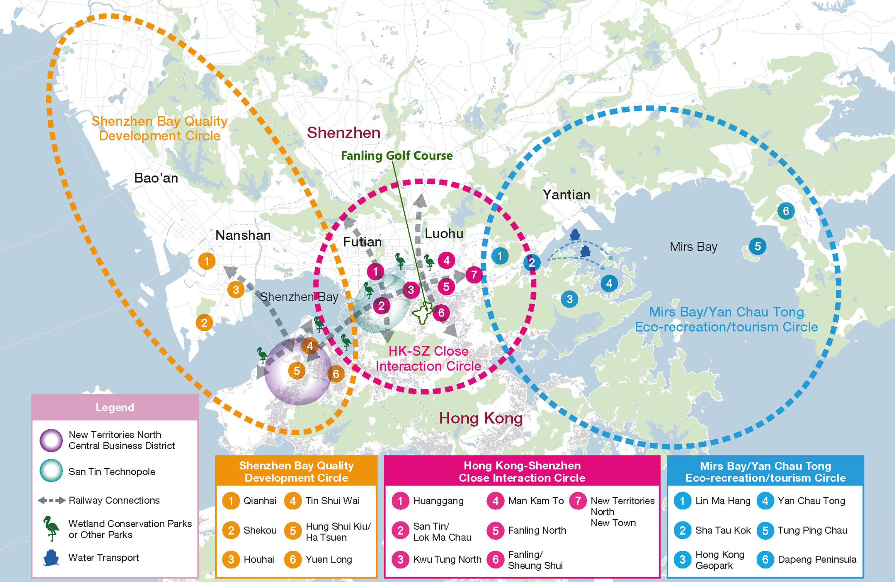
Strategic Importance of FGC to the Northern Metropolis
STRATEGIC SPATIAL FRAMEWORK
“Twin Cities, Three Circles”.
Fanling Golf Course is in the centre of the “HK-SZ Close Interaction Circle” and just east of the “San Tin Technopole”.
FGC already makes a very positive contribution to the “ecological habitat network inside the Circle” and it definitely “enhances the urban-rural landscape and the quality of life in the Circle.”
Destroying the Old Course would work directly against achieving these stated goals.
Based on
NMDSR
Figure, p.26
O.N.E. living heritage

Slide 10
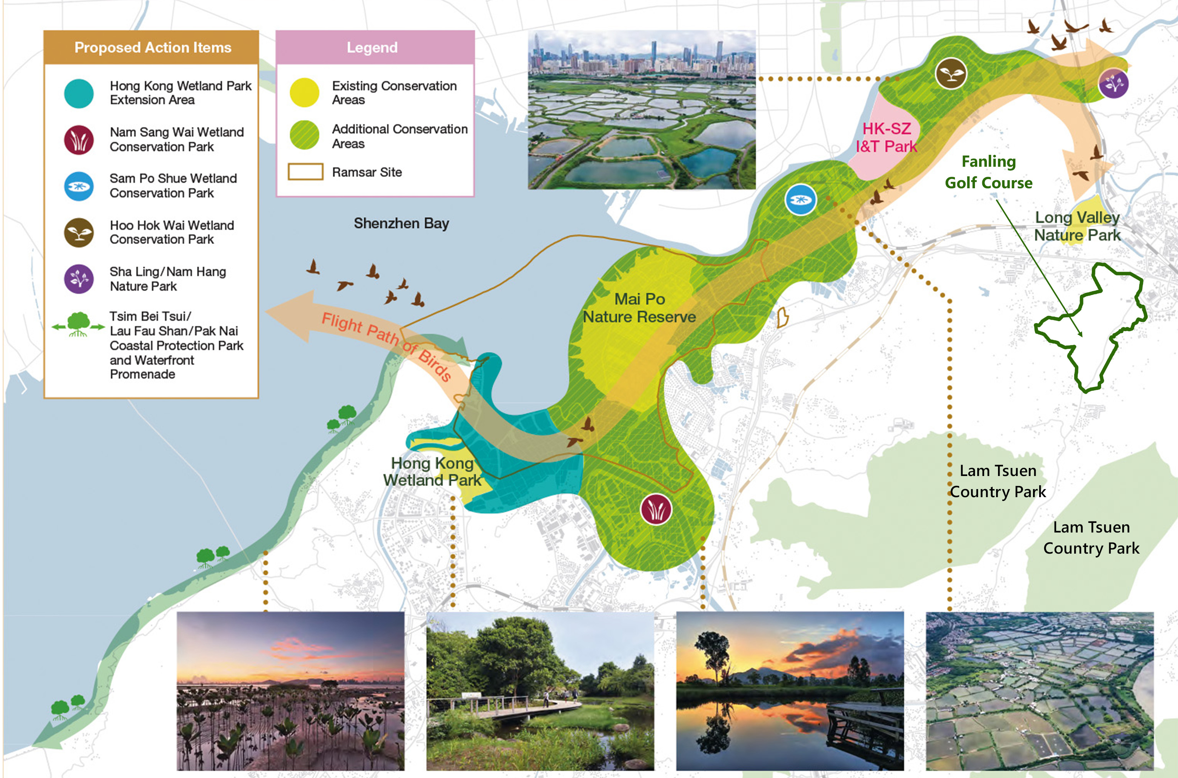
Strategic Importance of FGC to the Northern Metropolis
TEN KEY ACTION AND DIRECTION ITEMS
Implementing a Proactive Conservation Policy to Create Environmental Capacity.
There are five proactive conservation policies and measures located in various strategic development areas highlighted under this Key Action Direction.
The fourth policy is “Creating an ecological habitat network”.
Based on NMDSR
Figure, p.51
O.N.E. living heritage

Slide 11
Strategic Importance of FGC to the Northern Metropolis
TEN KEY ACTION AND DIRECTION ITEMS
Implementing a Proactive Conservation Policy to Create Environmental Capacity.
There are five proactive conservation policies and measures located in various strategic development areas highlighted under this Key Action Direction.
The fourth policy is “Creating an ecological habitat network”.
FGC already possesses high ecological value and forms a vital part of the ecological habitat network.
Based on NMDSR
Figure, p.51
O.N.E. living heritage

Slide 12
Fanling Fauna
Aquatic Fauna
Birds
Mammals
Reptiles
Amphibians
Butterflies and Moths
Dragonfly
182 73
32 25
23 14
11 2
118+729
11+107
40 3
42 3
species,
species,
species,
species,
species,
species,
species,
of conservation significance
of conservation significance
of conservation significance
of conservation significance
of conservation significance
of conservation significance
of conservation significance
1,177 species 238 of conservation significance

Slide 13
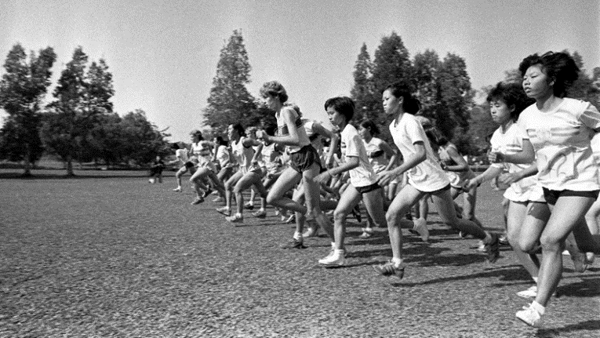
Strategic Importance of FGC to the Northern Metropolis
TEN KEY ACTION AND DIRECTION ITEMS
Creating Outdoor Eco-recreation/ Tourism Space with High Landscape Value.
The many local community facilities already provided by FGC in the Old Course include complimentary guided ecological and heritage tours for the public in addition to schools, universities, societies and associations (approximately 5 per week); a night walk trail that is open to the public daily from 5pm-9pm. Old Course is used by local organizations, including the North District Hospital, to hold charity fundraising walkathons, whilst HKGC also arranges public ‘Fanling Fun Days’ on the Old Course, which include tree-climbing, golfing, dog-walking and nature activities
O.N.E. living heritage

Slide 14
Strategic Importance of FGC to the Northern Metropolis
TEN KEY ACTION AND DIRECTION ITEMS
Making of Sustainable Community Suitable for Living in and Working.
The third component of this Key Action Direction is “Full implementation of the concept of sponge city construction” which states that
“The Northern Metropolis should be developed into a sustainable and carbon neutral smart community. Comprehensive efforts should be made to provide blue and green infrastructure with multiple functions and benefits in different strategic development areas. There should be a clear policy that the planning and design of the blue and green infrastructure should enable the Northern Metropolis to adapt to climate change and stand against extreme weather, so as to avoid bringing huge threats and damage to the community.”
It is self-evident that the destruction of the Old Course and the resultant loss of 9.5ha of woodland, grassland, topsoil and ecological habitats, and its replacement with the incredibly dense PHD with impermeable finishes is diametrically opposed to this Key Action Direction.
O.N.E. living heritage

Slide 15
Strategic Importance of FGC to the Northern Metropolis
Northern Metropolis Development Strategy Report (June 2021)
Development of FGC for housing would be in direct contradiction of all three of the NMDSR’s Strategic Directions, four of the six Planning Principles and three of ten Key Action Directions.
Preservation of FGC is in total harmony with all Northern Metropolis
strategic policy objectives.
O.N.E. living heritage

Slide 16
Strategic Importance of FGC to the Northern Metropolis
GLOBAL PERSPECTIVE
CATASTROPHIC CLIMATE CHANGE
CATASTROPHIC BIODIVERSITY COLLAPSE
INSECT APOCALYPSE
The “Tragedy of the Commons” writ large
Our generation must draw the line – no more incremental destruction of priceless ecological habitats & biodiversity for the sake of endless development expansion. Especially when PlanD admits the “housing is surplus to requirements”!
THAT IS NOT “BALANCE”
Please zone the whole 32 Ha as OU(CR)
and allow the Club to continue its successful stewardship of land over the past 112 years
O.N.E. living heritage

