Slide 1
Old•New•Eden
O.N.E. living heritage
Representation in respect of The Draft Fanling/Sheung Shui Extension Area OZP No. S/FSSE/1
June 2023

Slide 2
DRAINAGE
O.N.E. living heritage

Slide 3
CHANGING IMPERMEABLE to PAVED
Existing
Proposed development
TOTAL RUNOFF
TOTAL RUNOFF
+
+
18% Paved + 82% impermeable
70% Paved + 30% impermeable
O.N.E. living heritage

Slide 4
EXISTING SURFACE RUNOFF
O.N.E. living heritage

Slide 5
CHANGING NATURAL to PAVED SURFACES
O.N.E. living heritage

Slide 6
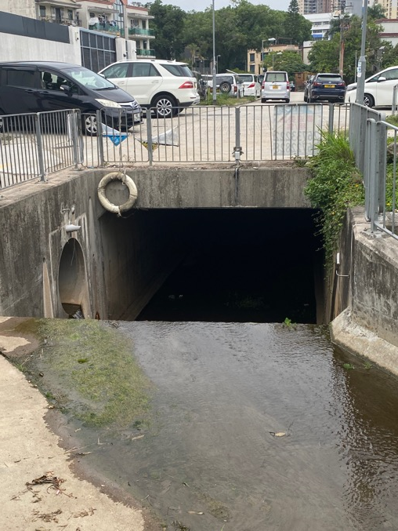
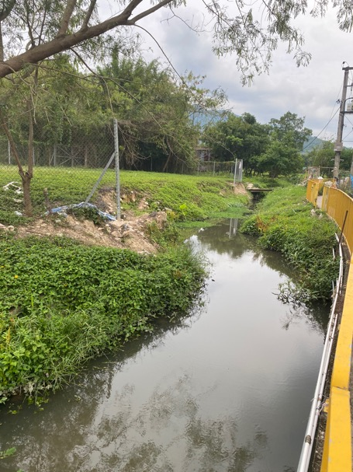
PING KONG VILLAGE
Road Level 12.8m PD
O.N.E. living heritage

Slide 7
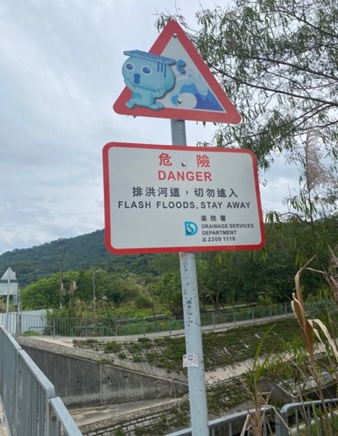
CAPTURING AND KEEPING STORMWATER SAFELY UNDERGROUND
72-yo Lee Yiu-jo drowned in his Ying Pun village home while rescuers were stuck in traffic
(22 July 2022)
SSRDC and NDRC in raising objections to the draft OZP (§ 3.2 of the TPB paper) raised potential adverse drainage as one of their 4 main concerns
O.N.E. living heritage

Slide 8
DESIGNING FOR STORMWATER RUNOFF – IDF CURVES
Site currently 82% green
4-Hour storm adopted in EIA
30-minute storm critical for local impacts
30% greening required by DevB TC 3/2012
??? Indicated on layout plans
O.N.E. living heritage

Slide 9
DRAINAGE CONCLUSIONS
The drainage condition in Sub Area 1 (2,3,4, and surrounding 500m area cannot be preserved. S2.6 of the TPB paper refers.
The DIA has adopted an inappropriate design storm
The DIA has undersized the stormwater drains in the vicinity
The DIA has failed to describe “blue-green” mitigation measures.
The development will cause an increased risk of overland flow both in terms of depth and velocity – this presents increased economic consequences and risk to life.
O.N.E. living heritage

