Slide 1
Old•New•Eden
O.N.E. living heritage
Representation in respect of The Draft Fanling/Sheung Shui Extension Area OZP No. S/FSSE/1
June 2023

Slide 2
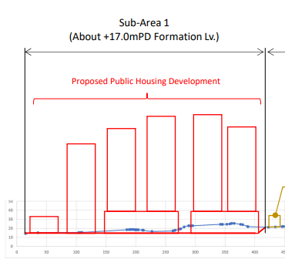
Topography of developed site Cross-section from North-East to South-West
Notes:
South-West Podium requires excavation of existing ground from+26mPD to +13-14mpd.
Significant cut volumes – order of 300 - 400,000m3 not including foundations and piles
Adverse effect on hydrology
Building heights to +164mPD (approx. 150m above surrounding ground level).

Slide 3
Construction Programme
Expected Programme for Completion – from Jun 2023
Pre-contract tasks, and procedures, design and tender to contract start
Previous programme wildly unrealistic and designed to meet the TFLS 10 year 2029 target.
Expected Key Procedural Steps and Time Requirements – to approval for contract commencement);
Site resumption – 1 Sep 2023
Estimated approx. 51 months to contract commencement
Earliest construction start – Sep 2027

Slide 4
Expected Programme for Completion – On Site
Expected Programme from contract award:
Key Contract Construction Works Time Requirements – from EIA.
Construction contract period envisaged in EIA – 6 years 2024-2029
From now expected contract commencement on Sep 2027, + 6 years plus expected extension of 20-25%
Expected contract completion end Dec 2034 to Mar 2035
Notes:
, ie an completion likely by

Slide 5
Even Many Programme Impediments
No allowance for poor ground / unexpected soil conditions,
Plus time for potential ground decontamination;
Plus time for improvement of capacity-constrained traffic capacity junctions and roundabouts;
Expansion of the North District Acute Hospital will constrain and be constrained by traffic generated by the FGC-PD; and
Restrictions of traffic capacity north of the site due to FGC-PD’s major sewerage and storm drainage improvements;
Etc.

Slide 6
More Programme Impediments
Additional road traffic arising from:
Disposal of EIA 950,000m3 C&D waste = 400 traffic movements/day over 4.5 years;
Plus unaccounted 25% more trees to be felled;
Trucking for concrete, building materials and construction materials, workers to site;
Site and tower height may be unsuitable for MiC;
Etc.

Slide 7
Overall Summary
The site layout is dense and very crowded;
Expect 2-3 or more separate contractors based on Housing Authority norms;
CEDD’s plans for FGC-PC not achievable by end of 2029;
HKGC previously estimated mid 2032 earliest;
KK Ling told TPB “FGC-PD can provide housing in the next five years”. I hope he will share that information on how to achieve this to others in the Government, as Secretary for Development recently on record that 2029 is no longer possible;
and never was.
Adding EIA-related delays: optimistic estimate = Dec 2034 to Mar 2035.
DevB quoted: first Northern Metropolis housing comes on stream early 2030.
So TPB must ask: Why is FGC-PD relevant and needed?

