Slide 1
Environmental Impact Assessment (EIA)
EIA Study Brief (No.ESB-318/2019) Appendix H
O.N.E. living heritage

Slide 2
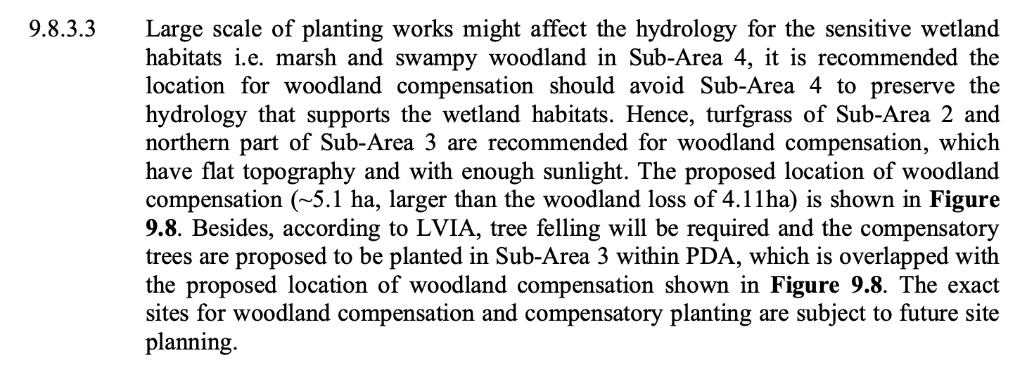
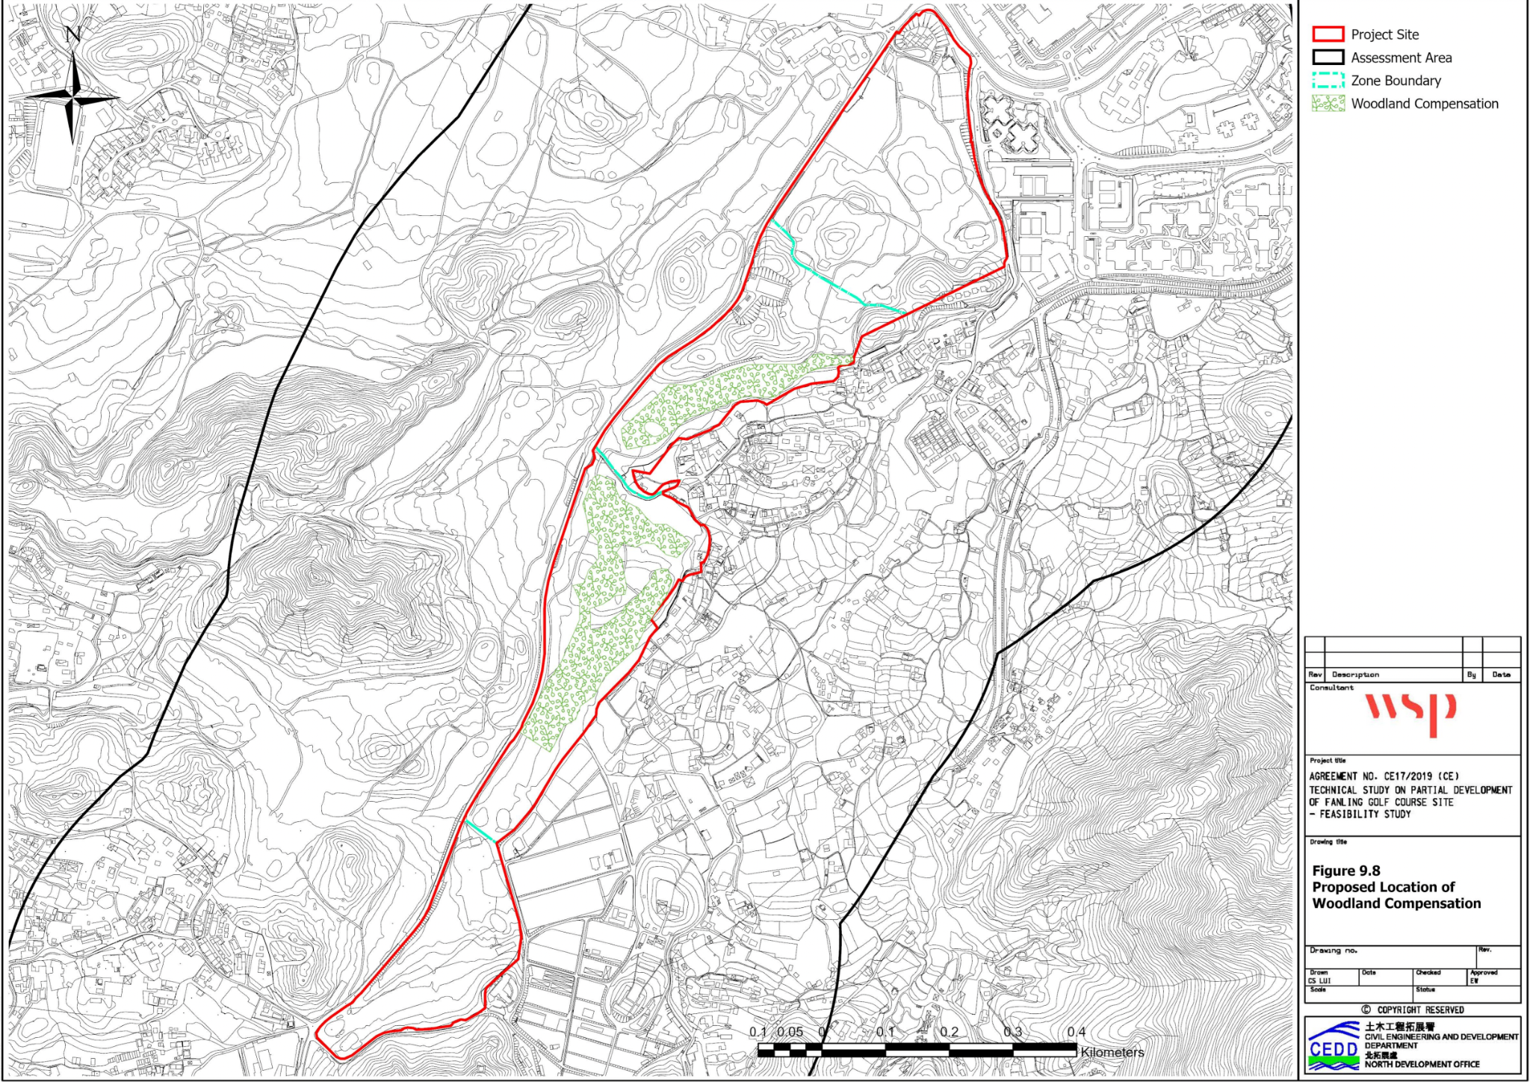
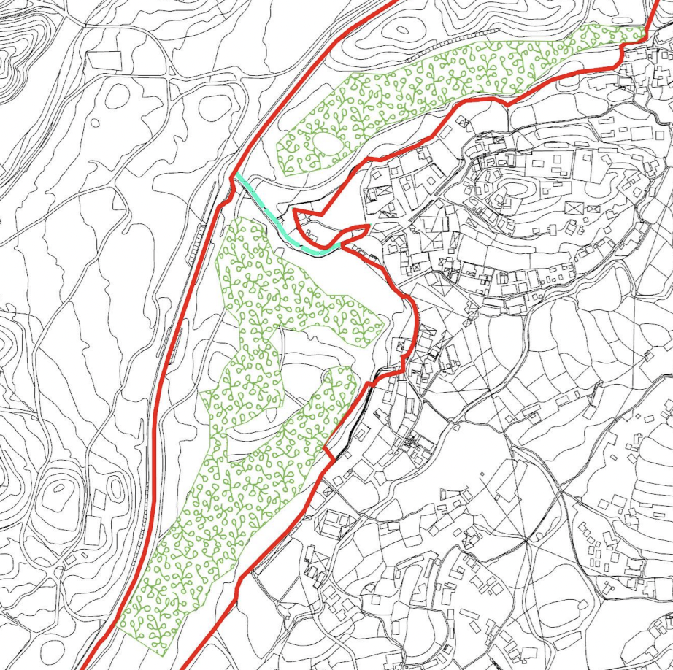
Environmental Impact Assessment (EIA)
EIA Section 9. Fig 9.8 "Proposed Location of Woodland Compensation"
O.N.E. living heritage

Slide 3
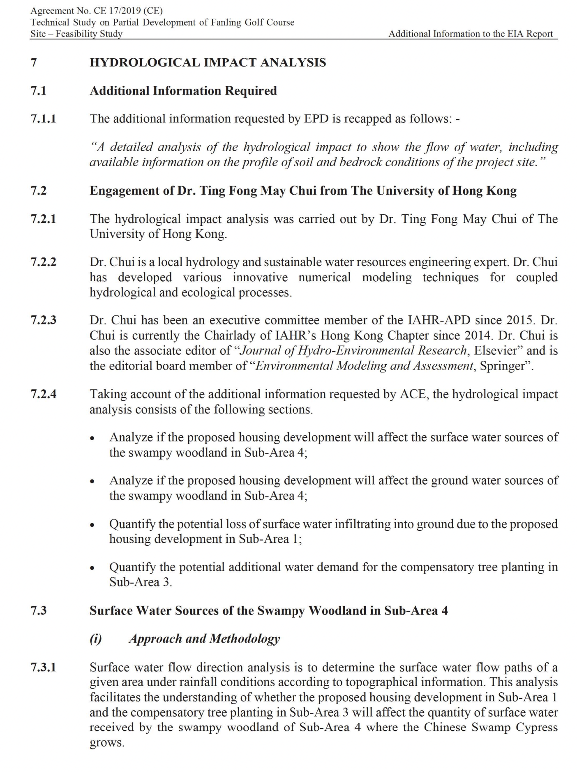
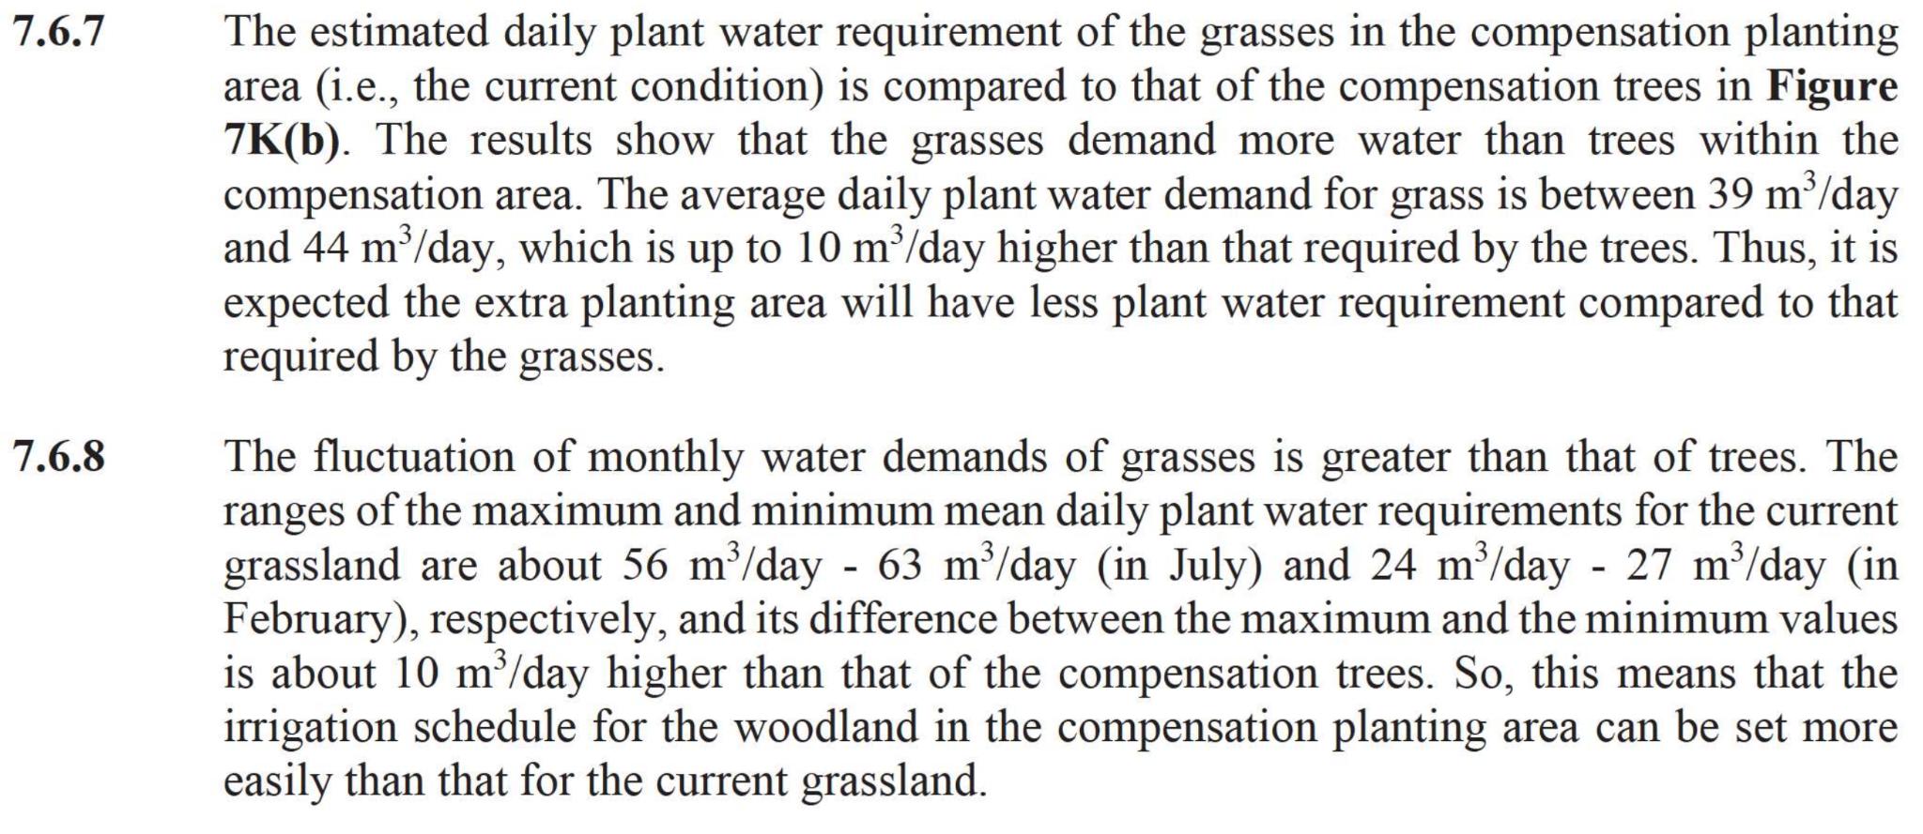
Environmental Impact Assessment (EIA)
Additional Hydrological Impact Analysis conducted by Dr. Ting Fong May Chui from the HKU
O.N.E. living heritage

Slide 4
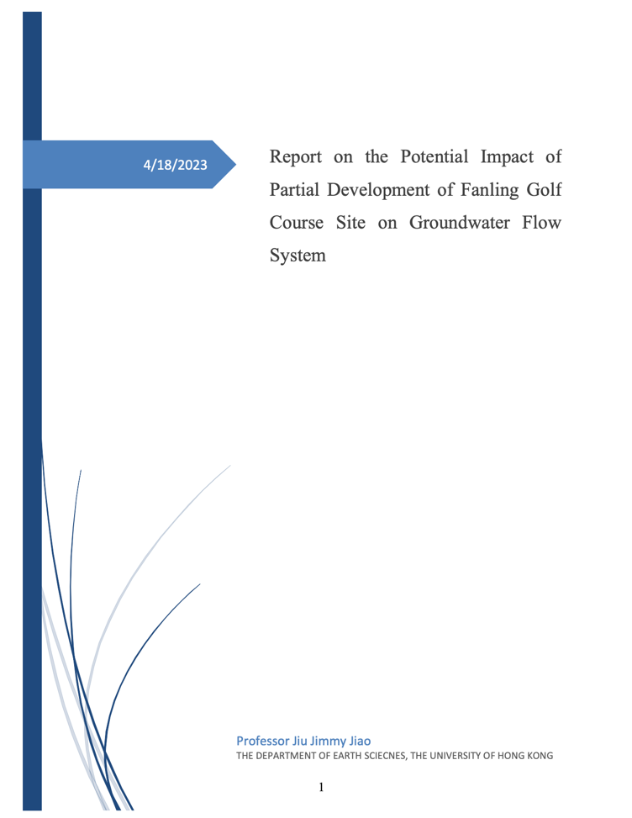
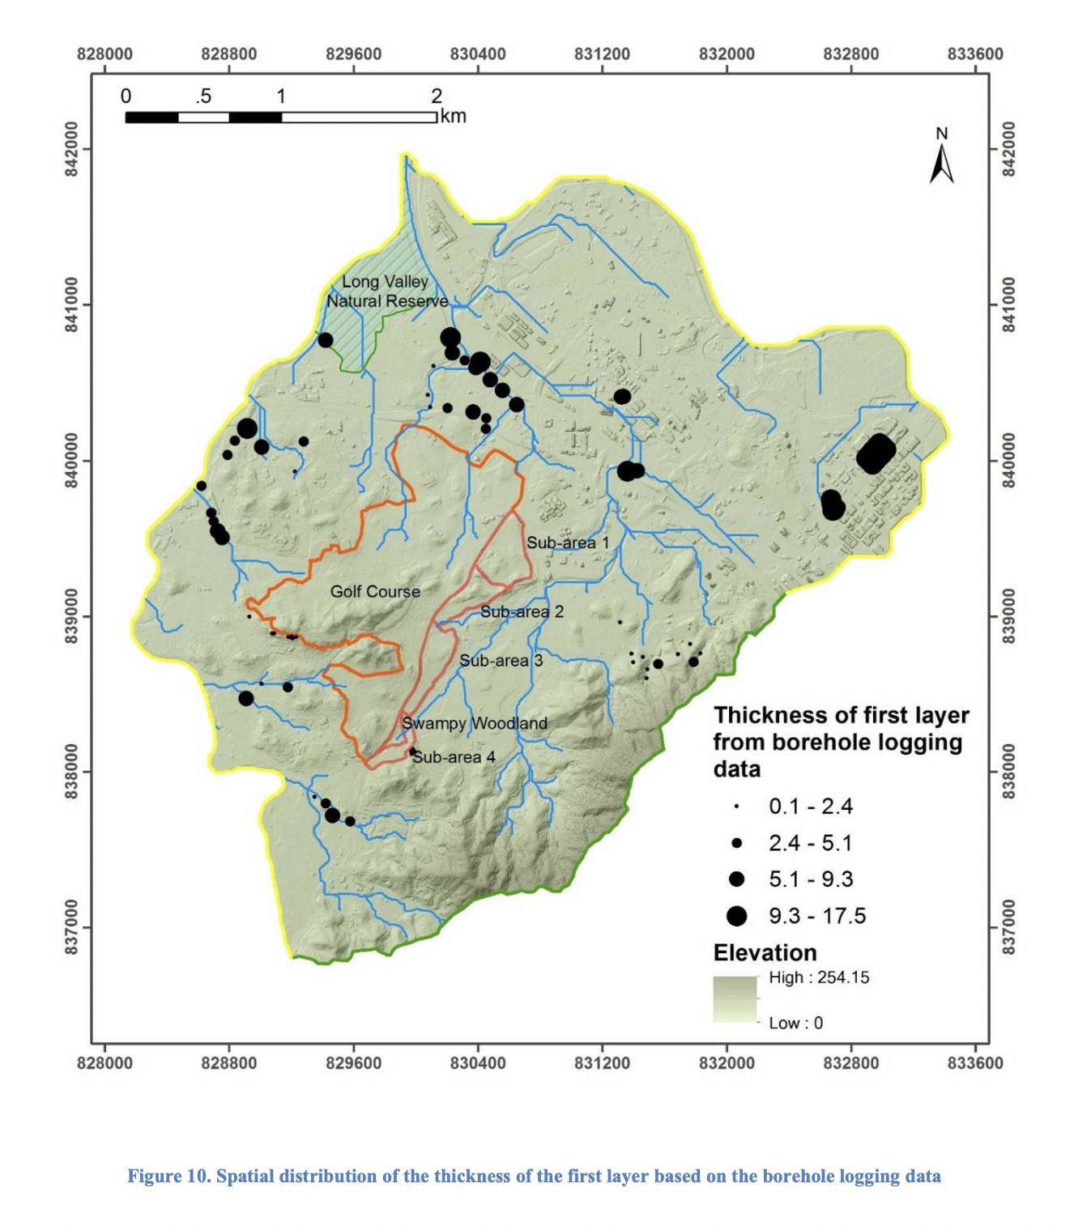
Advisory Council on the Environment (ACE) 2023
Additional CEDD studies showed no adverse hydrological impact to 1.4 ha of critically endangered Chinese Swamp Cypress (CSC) nursery.
HKGC’s hydrogeology survey and modelling concluded that R(A) and 5.1ha tree planting lowers water table by 0.84m and could adversely impact CSC survival.
HKGC's Report on the Potential Impact of FGC-PD on Groundwater Flow System
O.N.E. living heritage

Slide 5
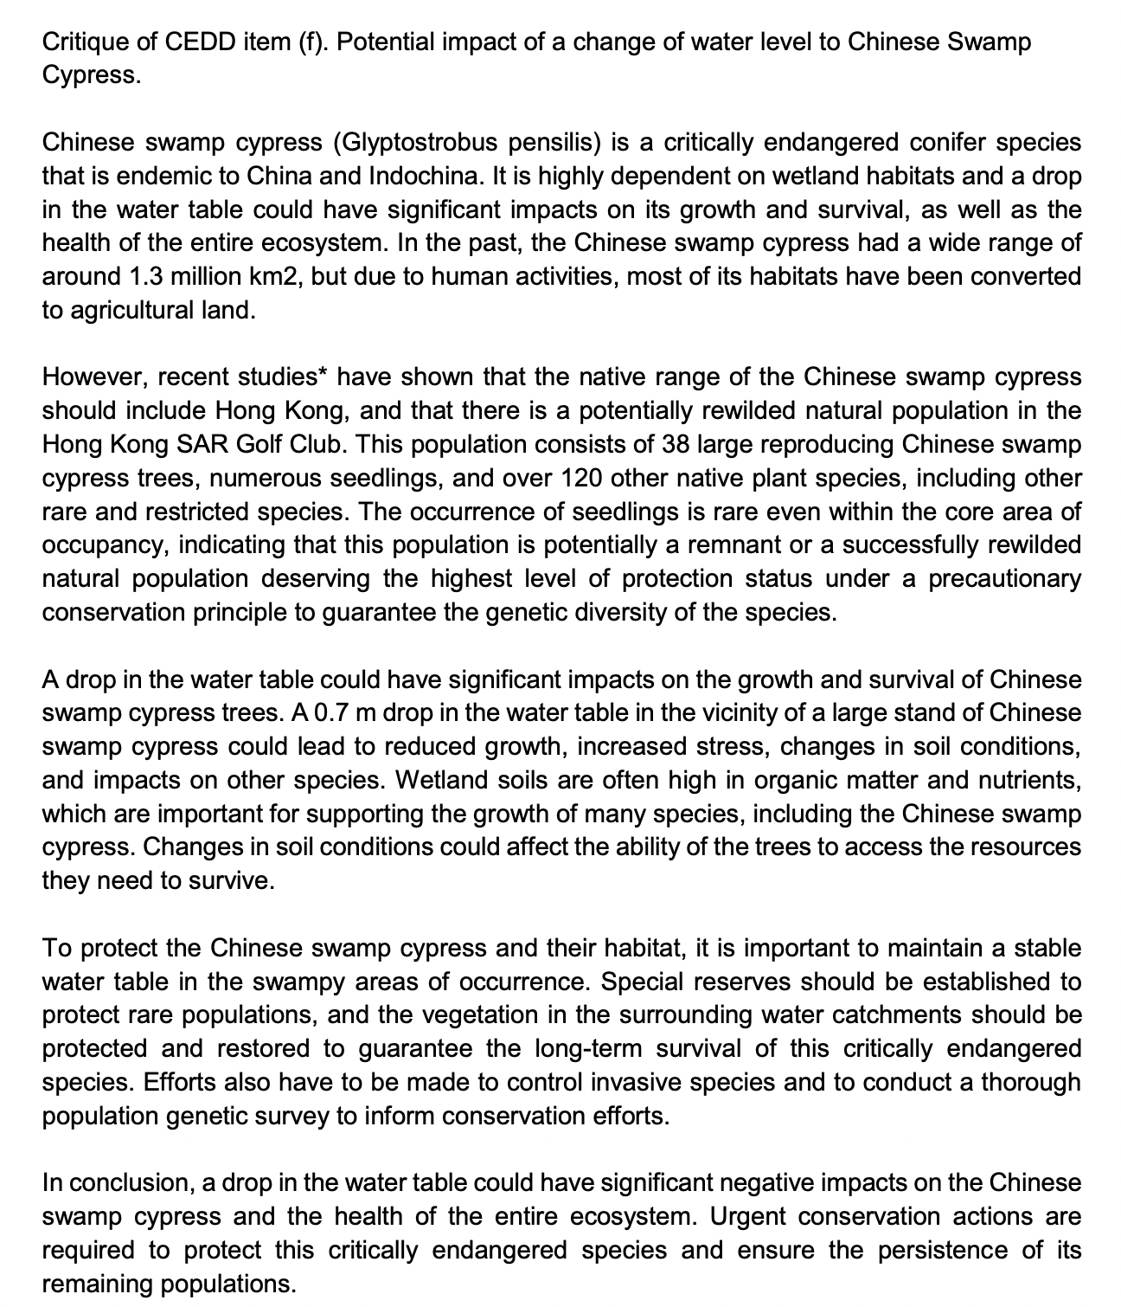
Advisory Council on the Environment (ACE)
Observation | Point D (Swampy Woodland) Drop in Water Table (m)
Before construction | 22.05 m
After construction and tree planting (4.1 ha) | -0.67m
After construction and tree planting (5.1 ha) | -0.84m
After construction and tree planting (6.15 ha) | -1.05m
O.N.E. living heritage

Slide 6
Advisory Council on the Environment (ACE)
CEDD's Green-Ampt infiltration method cannot provide any information on the water table change.
HKGC predicted adverse impact the survival of rare and water table sensitive, nationally and internationally protected and critically endangered, Chinese Swamp Cypress.
O.N.E. living heritage

