Slide 1
Old•New•Eden
O.N.E. living heritage
Representation in respect of The Draft Fanling/Sheung Shui Extension Area OZP No. S/FSSE/1
June 2023

Slide 2
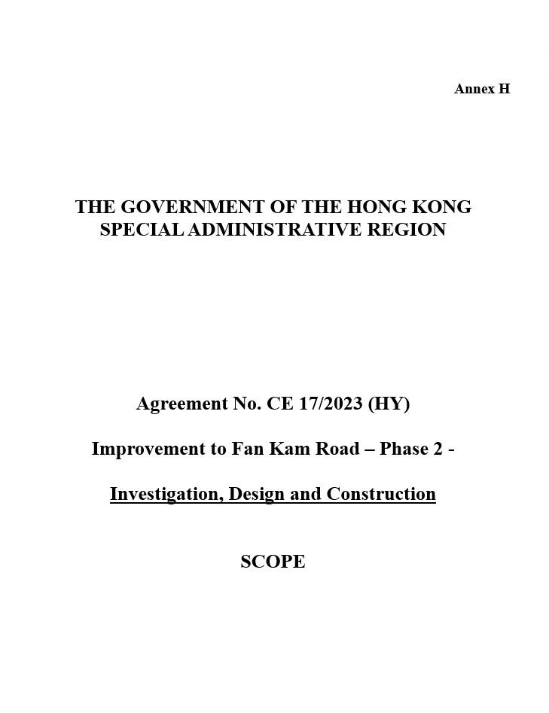
Invitation for technical and fee proposals issued 25 May 2023 by HyD.
14 Jun 2023 Chair/DPO said “we are leaving space on the north strip 10 m wide, and if necessary will expand the road but there’s no Highways Department timetable”.
O.N.E. living heritage

Slide 3
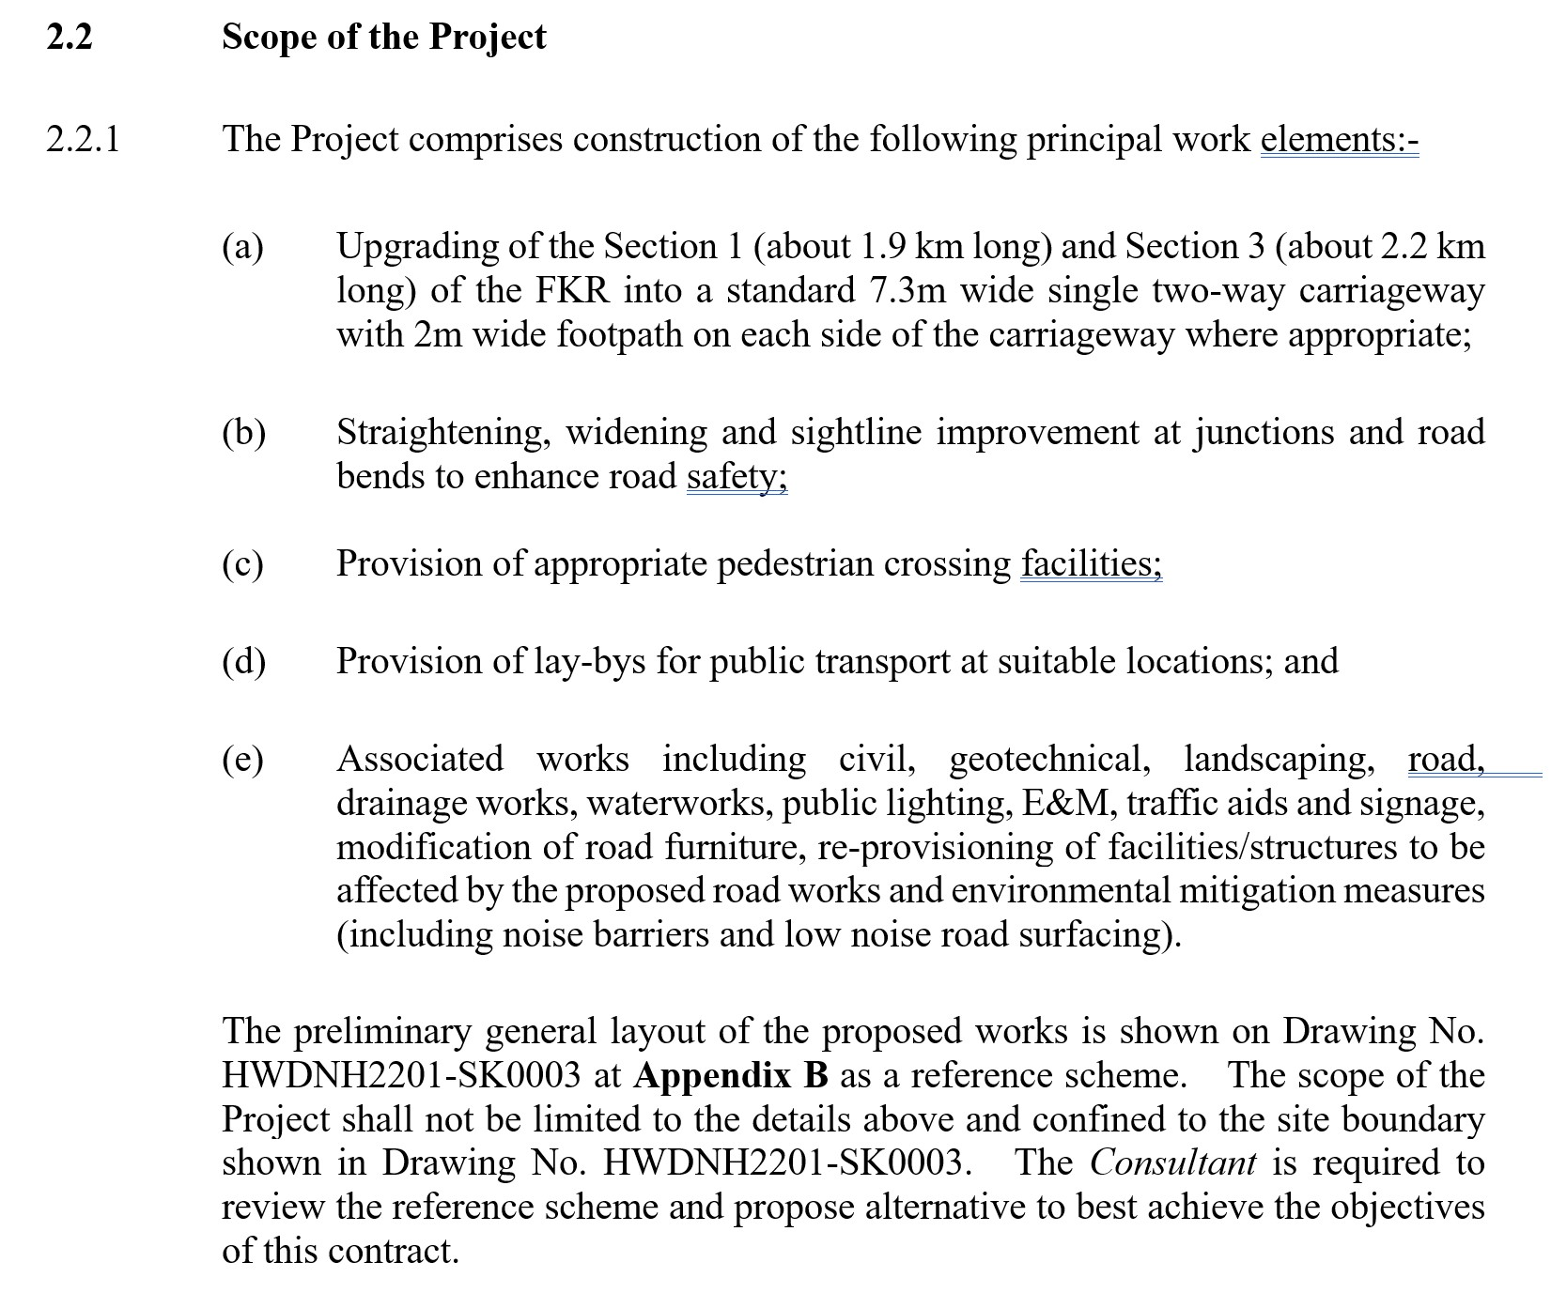
O.N.E. living heritage

Slide 4
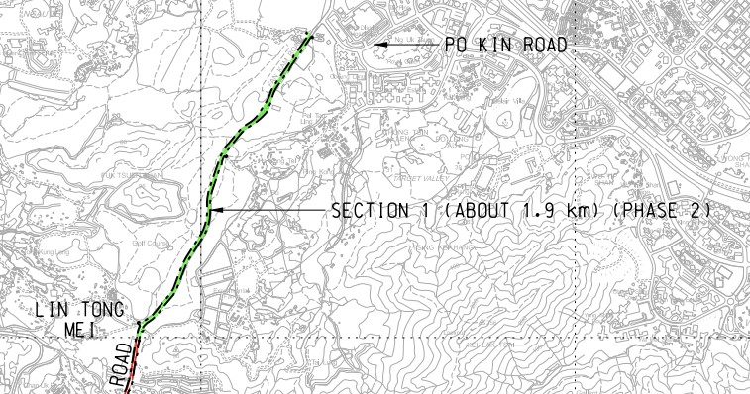
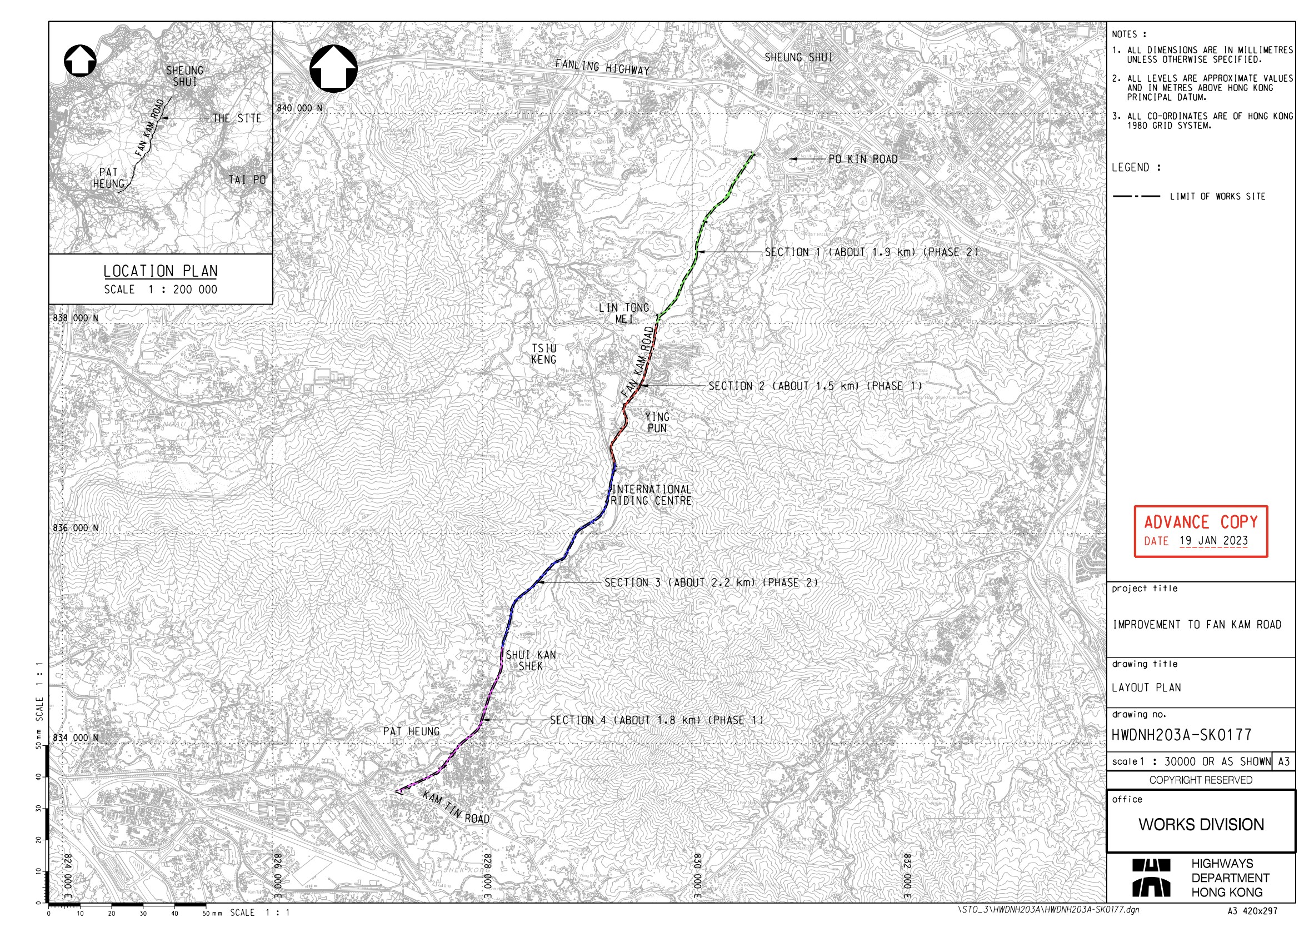
O.N.E. living heritage

